Slide 1
Lecture 1 – ARM Architecture
By Dr. Bard, Valvano
Modified by Dr. Min He

Slide 2
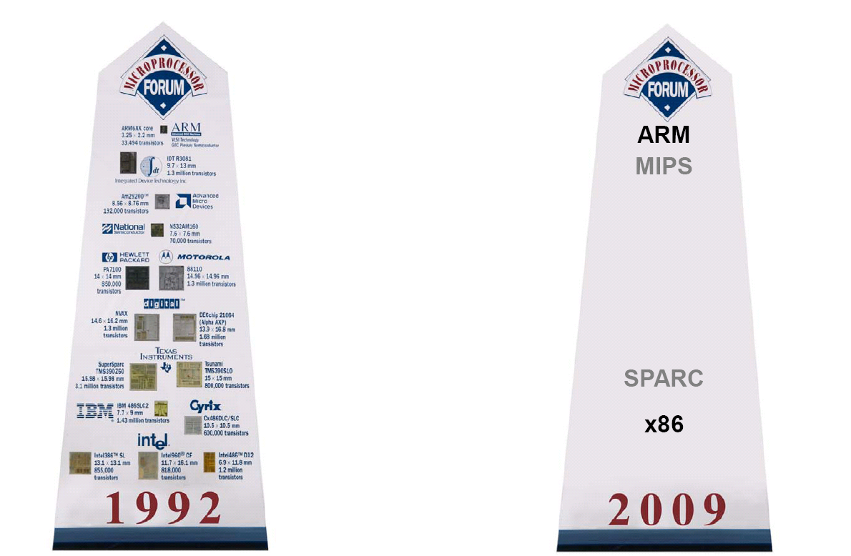
Why ARM?
95% of the world’s mobile handsets and more than 1/4 of all electronic devices use an ARM chip.
-CRN 11/19/10
1/27/2010

Slide 3
Introducing TI TM4C123
ARM Cortex-M4 processor
  Harvard architecture
    Different busses for instructions and data: having multiple buses means the processor can perform multiple tasks in parallel.
    There are many sophisticated debugging features utilizing the Dcode bus.
  RISC machine
    Pipelining effectively provides single cycle operation for many instructions
    Thumb-2 configuration employs both 16 and 32 bit instructions
      Increases code density
Notes:
Von Neumann machines have shared signals and memory for code and data.

Slide 4
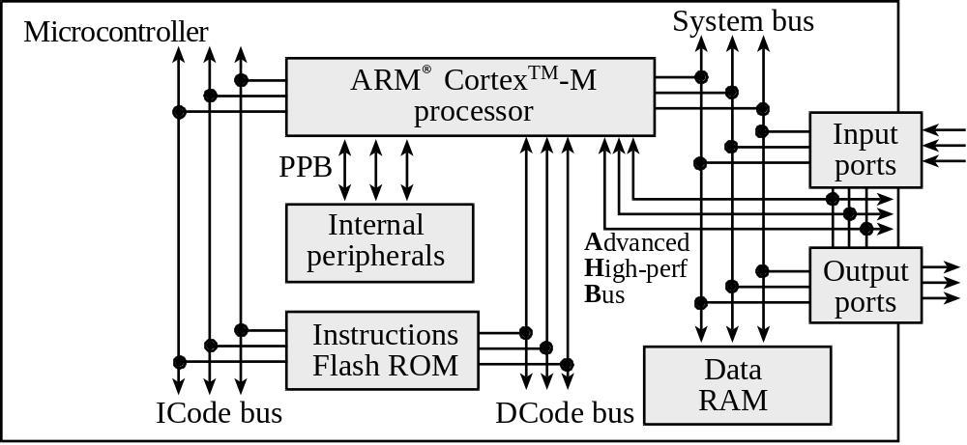
Cortex-M4
Advanced
Peripheral
Bus
TM4C123 GPIO on both buses
TM4C1294 GPIO only on AHB

Slide 5
System Buses
Data are exchanged with memory and I/O via the system bus interface.
PPB: Private Peripheral Bus
Used for communication between processor and internal peripherals, such as NVIC (nested vectored interrupt controller)
APB: Advanced Peripheral Bus
Used for communication between processor and external peripherals
AHB: Advanced High –Performance Bus
Used for high speed external devices like USB

Slide 6
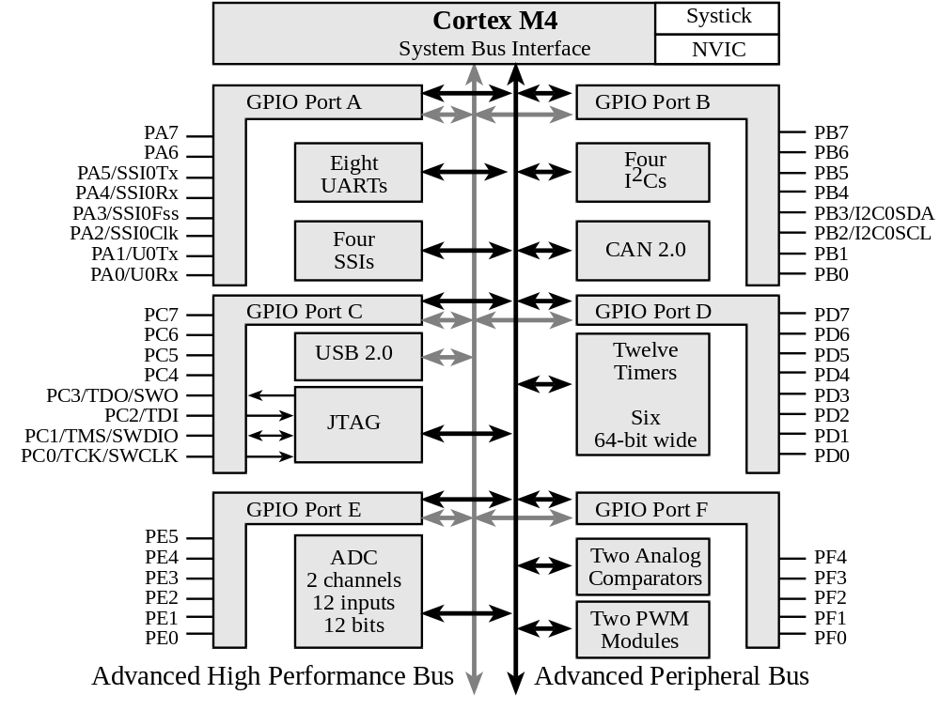
Input/Output: TM4C123
6 General-Purpose I/O (GPIO) ports:
Four 8-bit ports (A, B, C, D)
One 6-bit port (E)
One 5-bit port (F)

Slide 7
Interrupts
NVIC: nested vectored interrupt controller
Handles hardware-triggered software functions
Communicate directly with the processor via PPB, provide fast execution of interrupt service routines (ISRs), dramatically reducing the interrupt latency.

Slide 8
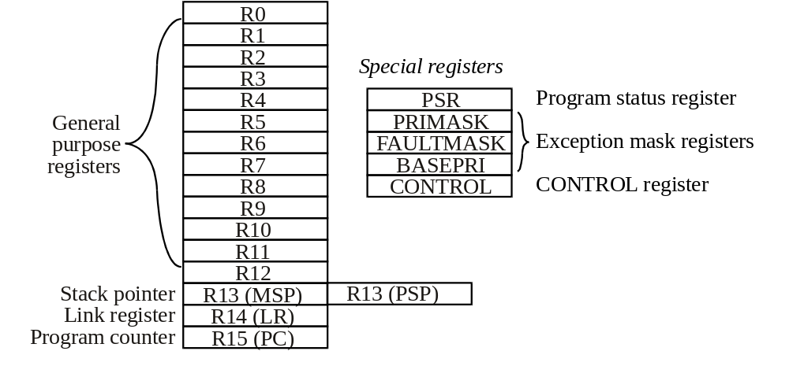
Cortex-M4 Registers
MSP – MAIN STACK POINTER
PSP – PROCESS STACK POINTER

Slide 9
Cortex-M4 Operating Modes
Thread mode is the foreground operating context
  This is the context in which your main program and associated subroutines operate
Handler mode is the background operating context
  This is the context in which the routines that service interrupt requests operate
Both operating modes employ the MSP

Slide 10
Memory Mapped Processor Architecture
In a system with memory mapped I/O
  I/O devices are connected like memory
  I/O devices are assigned addresses
  software accesses I/O using these addresses
  software inputs from an input device
    same instructions as a memory read
  software outputs from an output device
    same instructions as a memory write

Slide 11
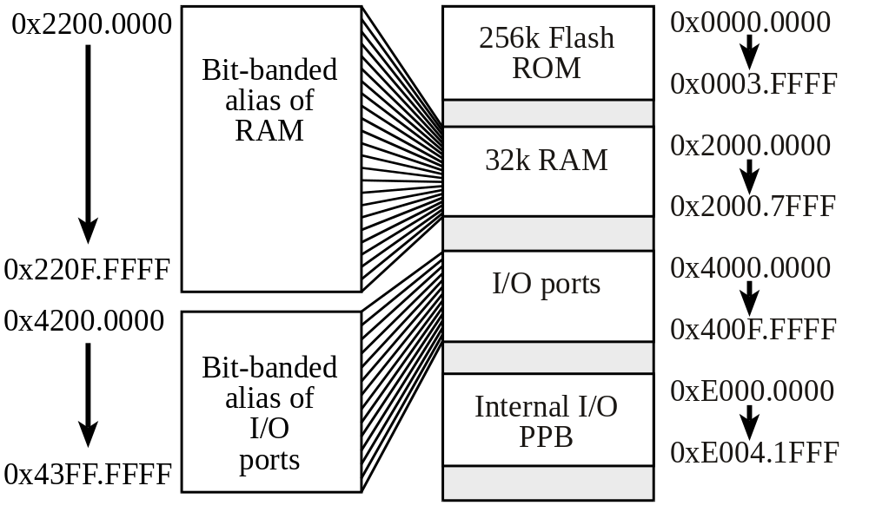
TM4C123
TM4C123 MEMORY MAP
Notes:
Bit-banding maps a complete word of memory onto a single bit in the bit-band region. For example, writing to one of the alias words will set or clear the corresponding bit in the bitband region.
This allows every individual bit in the bit-banding region to be directly accessible from a word-aligned address using a single LDR instruction. It also allows individual bits to be toggled from C without performing a read-modify-write sequence of instructions.

Slide 12
Memory Mapped Processor Architecture
The bus contains:
  address (input, output, RAM or ROM),
  data
  control information
The address specifies:
  which slave module will communicate with the processor
  one address per memory access cycle

Slide 13
Memory Mapped Processor Architecture
The data contains
  information that is being transferred.
Control signals specify
  the direction of the transfer.
We call a complete data transfer a bus cycle. The processor always controls
  the address (where to access),
  the direction (read or write), and
  the control (when to access.)

Slide 14
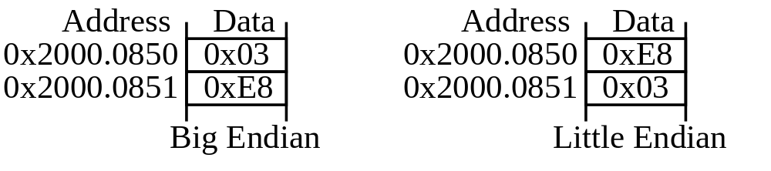
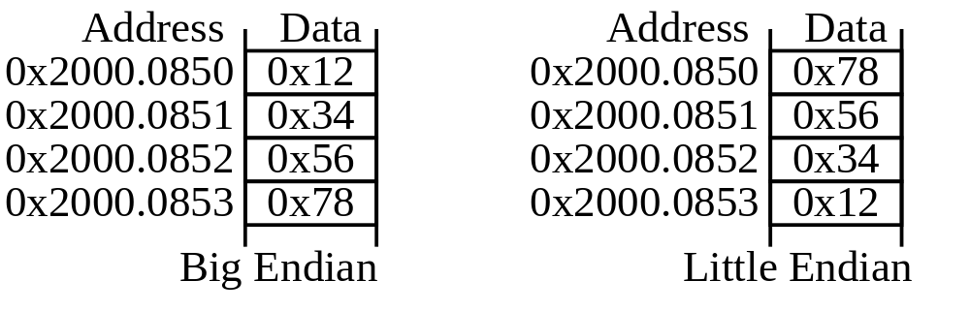
Cortex-M4 Memory System
– Uses Little Endian
STORING 0X03E8
STORING 0X12345678
ENDIANESS: BIG ENDIAN – MSB STORED IN SMALLEST ADDRESS
LITTLE ENDIAN – LSB STORED IN SMALLEST ADDRESS
CORTEX-M4 USES LITTLE ENDIAN

Slide 15
Cortex-M4 Instruction Set
The Cortex-M4 uses the Thumb-2 instruction set
  The Thumb-2 instruction set is a composite of both 32-bit ARM instructions and 16-bit Thumb instructions
  The processor is always running in Thumb-2 mode
  The Thumb-2 instruction set improves code density in comparison with the ARM instruction set
  We will use a subset of the Thumb-2 instruction set called Thumbnail

Slide 16
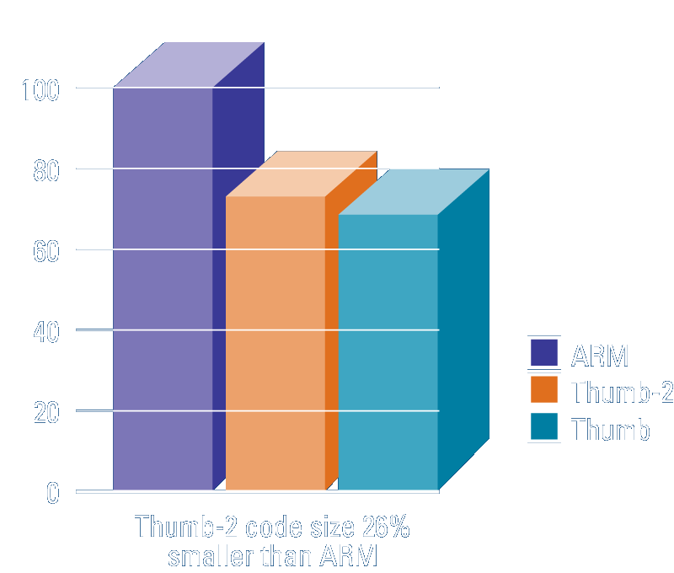
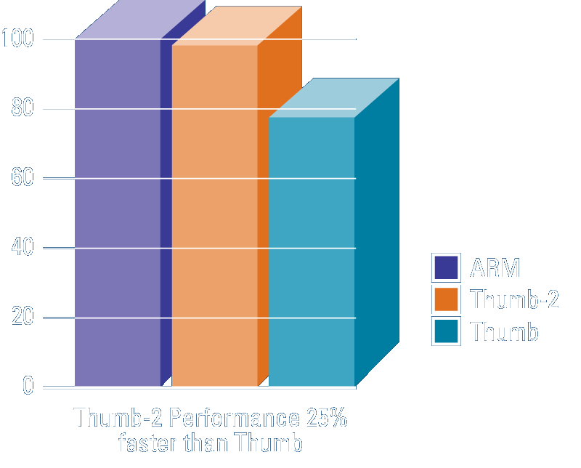
The Thumb-2 instruction set
Variable-length instructions
  ARM instructions are a fixed length of 32 bits
  Thumb instructions are a fixed length of 16 bits
  Thumb-2 instructions can be either 16-bit or 32-bit
Thumb-2 gives approximately 26% improvement in code density over ARM
Thumb-2 gives approximately 25% improvement in performance over Thumb
Notes:
In fact, Cortex-M3 implements only a SUBSET of the Thumb-2 instruction set.

Slide 17
Lab Setup
Text book Chapter 3: 3.1
http://users.ece.utexas.edu/~valvano/edX/InstallDrivers7.htm

